Slide 1
Predicting Credit Card Defaults

Slide 2
Data
Data was taken from Kaggle
This dataset contains information on default payments, demographic factors, credit data, history of payment, and bill statements of credit card clients in Taiwan from April 2005 to September 2005.
API
https://www.fraudlabspro.com/developer
A small amount of data was also collected from an API on credit card default data, but wasn’t used as it was too difficult to merge

Slide 3
1.
EDA
Working with our data

Slide 4
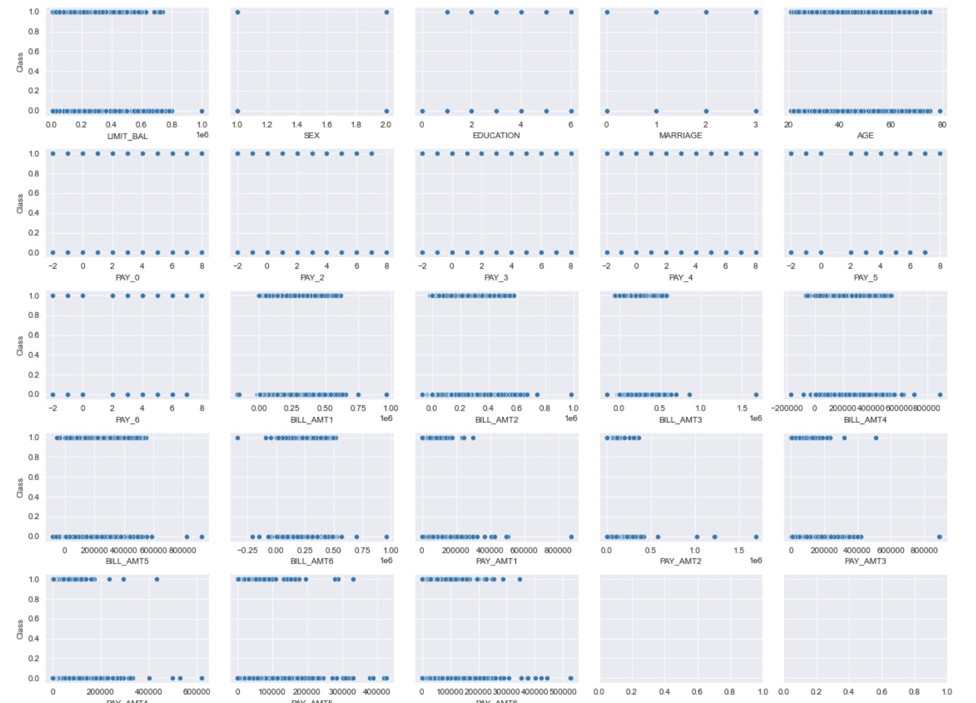
EDA
Relationship between target and predictor variables

Slide 5
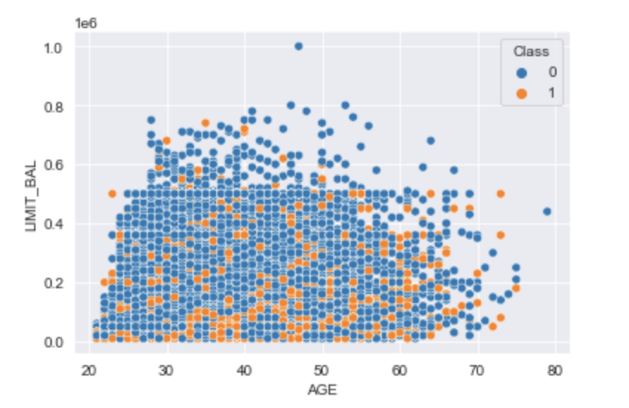
EDA
Probability a customer defaults based on age and their limit balance on their account

Slide 6
2.
Feature Engineering

Slide 7
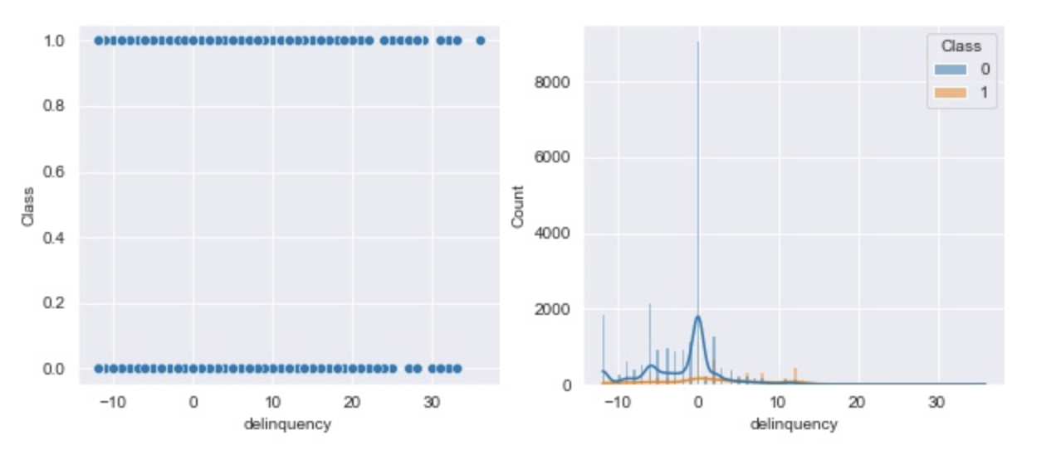
Feature Engineering
Delinquency, probability of default, and exposure at default are studied

Slide 8
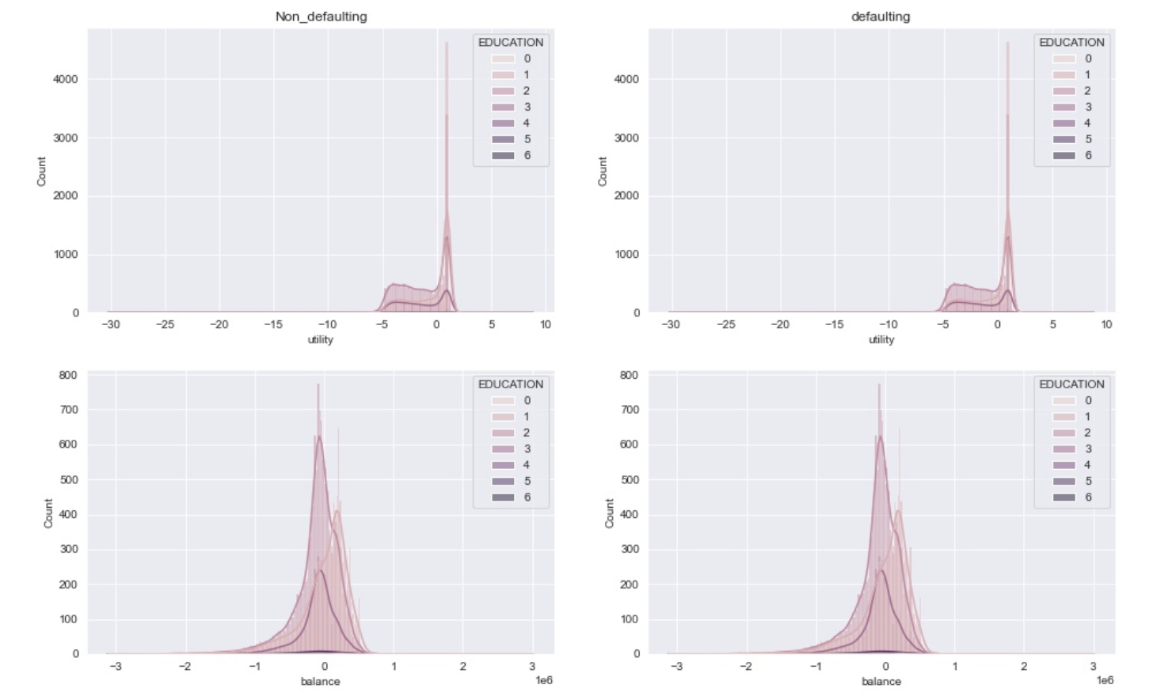
Feature Engineering
Distribution of credit utility based on Education between Defaulting and Non-defaulting customers

Slide 9
3.
Model Fitting

Slide 10
Big concept
Bring the attention of your audience over a key concept using icons or illustrations

Slide 11
You can also split your content
White
Is the color of milk and fresh snow, the color produced by the combination of all the colors of the visible spectrum.
Black
Is the color of ebony and of outer space. It has been the symbolic color of elegance, solemnity and authority.

Slide 12
In two or three columns
Yellow
Is the color of gold, butter and ripe lemons. In the spectrum of visible light, yellow is found between green and orange.
Blue
Is the colour of the clear sky and the deep sea. It is located between violet and green on the optical spectrum.
Red
Is the color of blood, and because of this it has historically been associated with sacrifice, danger and courage.

Slide 13
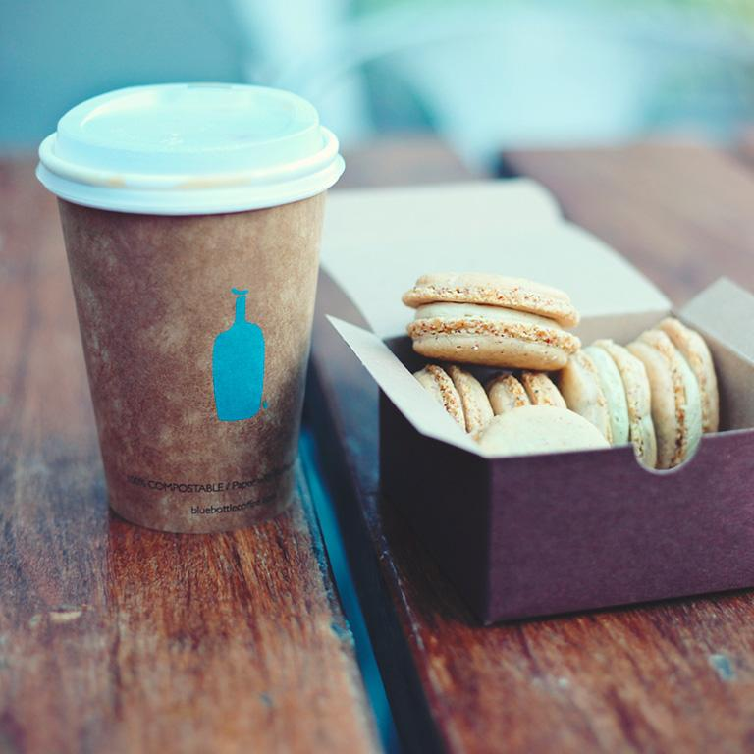
A picture is worth a thousand words
A complex idea can be conveyed with just a single still image, namely making it possible to absorb large amounts of data quickly.

Slide 14

Want big impact?
Use big image.

Slide 15
Use charts to explain your ideas
White
Gray
Black

Slide 16
And tables to compare data
 | A | B | C
Yellow | 10 | 20 | 7
Blue | 30 | 15 | 10
Orange | 5 | 24 | 16

Slide 17
Maps
our office

Slide 18
89,526,124
Whoa! That’s a big number, aren’t you proud?

Slide 19
89,526,124$
185,244 users
100%
That’s a lot of money
And a lot of users
Total success!

Slide 20
Our process is easy
first
second
last

Slide 21
Let’s review some concepts
Yellow
Is the color of gold, butter and ripe lemons. In the spectrum of visible light, yellow is found between green and orange.
Blue
Is the colour of the clear sky and the deep sea. It is located between violet and green on the optical spectrum.
Red
Is the color of blood, and because of this it has historically been associated with sacrifice, danger and courage.
Yellow
Is the color of gold, butter and ripe lemons. In the spectrum of visible light, yellow is found between green and orange.
Blue
Is the colour of the clear sky and the deep sea. It is located between violet and green on the optical spectrum.
Red
Is the color of blood, and because of this it has historically been associated with sacrifice, danger and courage.

Slide 22
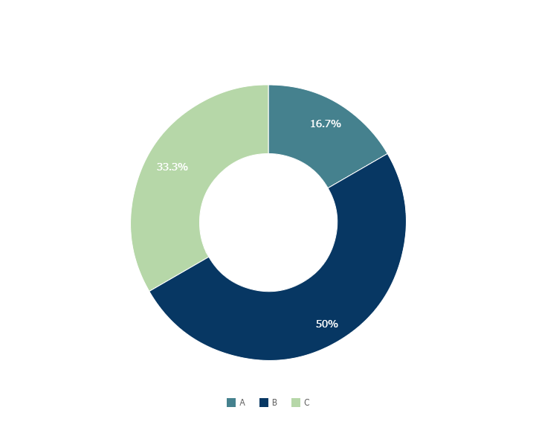
You can copy&paste graphs from Google Sheets

Slide 23

Mobile project
Show and explain your web, app or software projects using these gadget templates.

Slide 24

Tablet project
Show and explain your web, app or software projects using these gadget templates.

Slide 25

Desktop project
Show and explain your web, app or software projects using these gadget templates.

Slide 26
Thanks!
Any questions?
You can find me at
@username
user@mail.me

Slide 27
Credits
Special thanks to all the people who made and released these awesome resources for free:
Presentation template by SlidesCarnival
Photographs by Unsplash

Slide 28
Presentation design
This presentations uses the following typographies and colors:
Titles & Body copy: Montserrat
You can download the fonts on this page:
https://www.fontsquirrel.com/fonts/montserrat
Grey #454f5b
Light grey #738498
Neon green #c7f464
Aqua #4ecdc4
You don’t need to keep this slide in your presentation. It’s only here to serve you as a design guide if you need to create new slides or download the fonts to edit the presentation in PowerPoint®

Slide 29
SlidesCarnival icons are editable shapes.
This means that you can:
Resize them without losing quality.
Change fill color and opacity.
Change line color, width and style.
Isn’t that nice? :)
Examples:

Slide 30
Diagrams and infographics

Slide 31
Now you can use any emoji as an icon!
And of course it resizes without losing quality and you can change the color.
How? Follow Google instructions https://twitter.com/googledocs/status/730087240156643328
😉
✋👆👉👍👤👦👧👨👩👪💃🏃💑❤😂😉😋😒😭👶😸🐟🍒🍔💣📌📖🔨🎃🎈🎨🏈🏰🌏🔌🔑 and many more...

Slide 32

Free templates for all your presentation needs
For PowerPoint and Google Slides
100% free for personal or commercial use
Ready to use, professional and customizable
Blow your audience away with attractive visuals

